Slide 1
CSE 161 – Design and Architecture of Computer Systems
Memory Systems
A – DRAM & SRAM Memories
B – Cache Designs

Slide 2






memory systems
We’ve already seen how to make a fast processor. How can we supply the CPU with enough data to keep it busy?
We will now focus on memory issues, which are frequently bottlenecks that limit the performance of a system.
We’ll start off by looking at memory systems for the next two weeks.
Processor
Memory
Input/Output

Slide 3
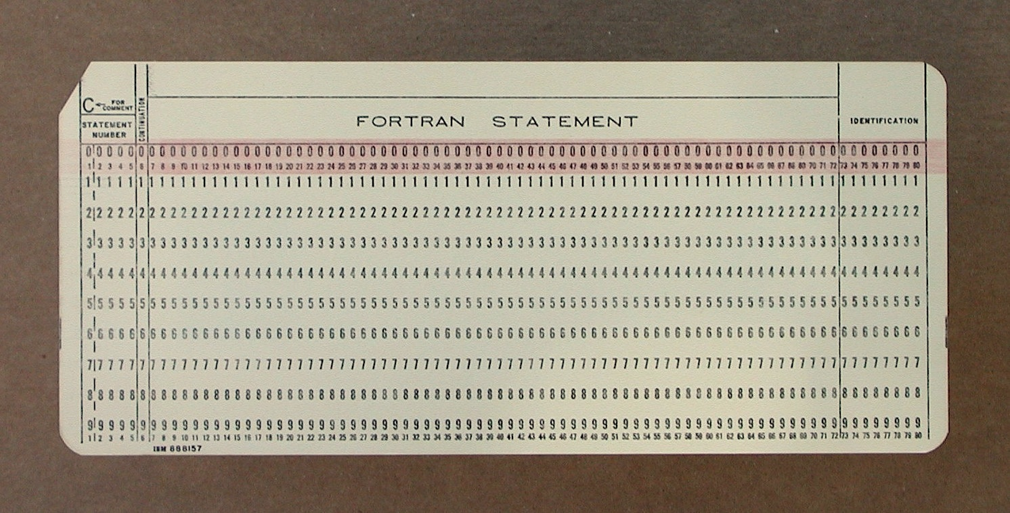
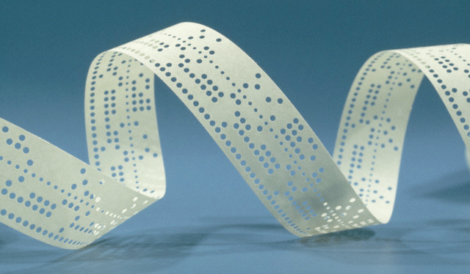
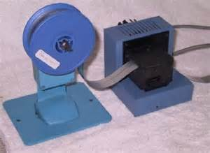
some early read-only-memory
Punched card – first widespread use in the Jacquard loom (18th century Lyon, France)
Then IBM, 50s to 70s
Punched paper tape –
used in Harvard Mark 1,
many early personal
systems

Slide 4
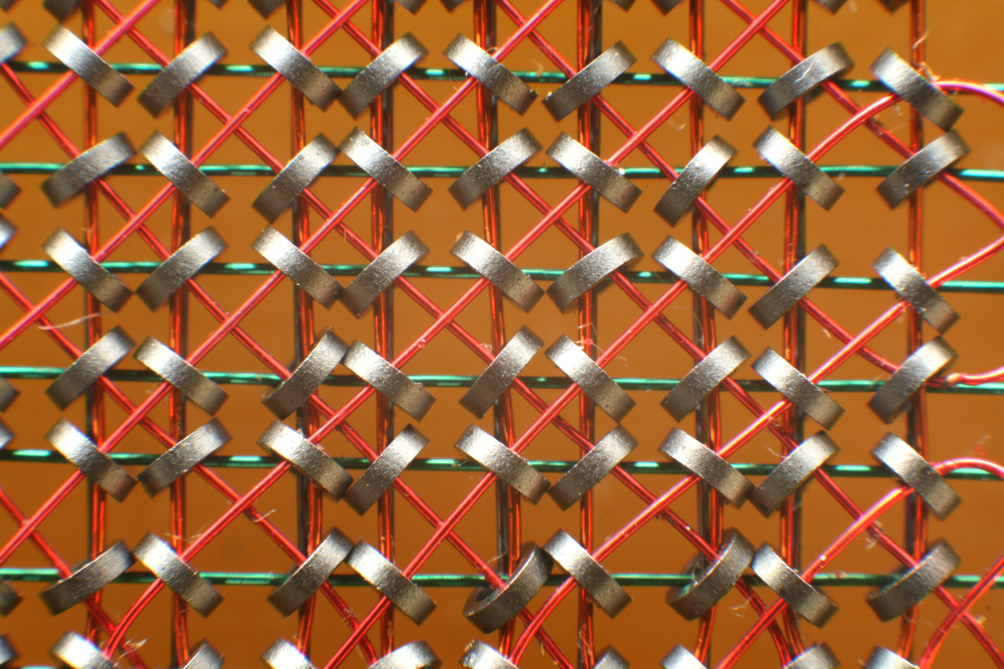
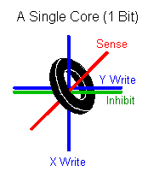
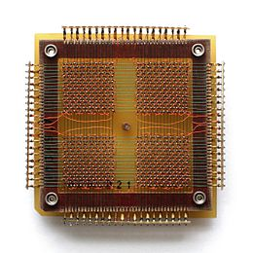
early read/write memories
Magnetic core – first large scale electronic storage.
Invented at MIT for Whirlwind Project (50s)
Used on space shuttle computers
Core access time approx. 1μs
32x32 memory: 1 Kb data

Slide 5
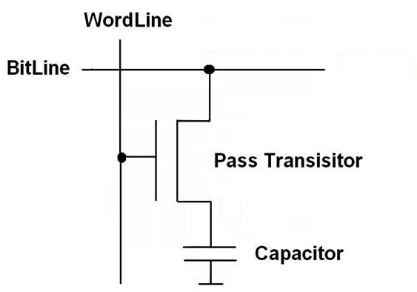
DRAM - Dynamic Random Access Memory
Principle:
store value as a charge in a capacitor,
capacitor slowly discharges, refresh to preserve stored value
first use: machine Aquarius at Bletchley Park during World War II
History
First patent: Dr. Robert Dennard, IBM TJ Watson, 1968
First chip: Intel 1103 (Oct 1970)
1973 Mostek introduces MK4096 (4Kb DRAM)
first with multiplexed row and column address lines
16 Kbit Mostek MK4116 (1976), achieved >75% worldwide DRAM market share

Slide 6
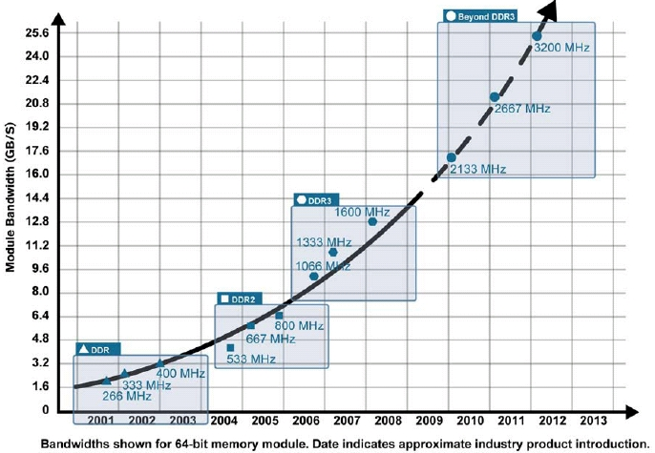
DRAM bandwidth

Slide 7
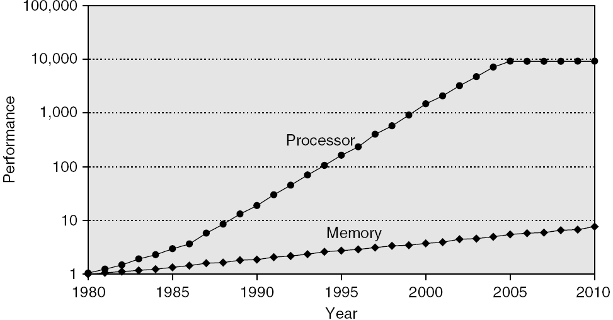
performance gap
memory latency
Example: 4-issue 2GHz processor with 100ns DRAM: 800 instructions in the time of 1 memory access

Slide 8
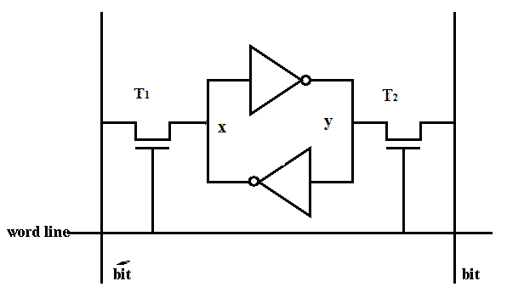
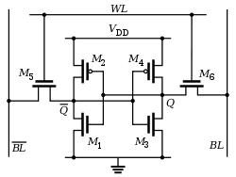
SRAM
no need to refresh
6 transistors instead of 1
much faster and larger in area than a DRAM cell
higher power consumption
used for CPU registers and caches (on-chip)
leakage current becomes a problem (dark silicon)

Slide 9
small or slow
Trade off between speed, cost and capacity.
Fast memory is too expensive.
But dynamic memory has a much longer delay than other functional units in a datapath.
If every lw or sw accessed dynamic memory, we’d have to either increase the cycle time or stall frequently.
Storage | Speed | Cost | Capacity
Static RAM | Fastest | Expensive | Smallest
Dynamic RAM | Slow | Cheap | Large
Hard disks | Slowest | Cheapest | Largest
Storage | Delay | Cost/GB
Static RAM | 0.5 – 2.5 ns | $1,000’s
Dynamic RAM | 50 – 70 ns | $10’s
Hard disks | 5 – 20 ms | $0.1’s
Notes:
The Athlon XP 1500+ with 384KB of total cache runs at 1.33GHz and retails for $52; a 1.3GHz Duron with 192KB cache retails for $44 as of 3/12/03.
A 2.2GHz Pentium 4 with a 512KB L2 cache sells for $163, while the 2.2GHz Celeron with 128KB of L2 costs $103 as of 2/23/03.
As of 4/15/03, a 128MB PC2700 DIMM at crucial.com costs $27, and a 512MB PC2700 DIMM is $80.
$63 for an OEM 20GB 7200 RPM Maxtor drive at newegg.com, and $118 for an OEM 120GB 7200 RPM Maxtor.

Slide 10

distance matters
CPU memory bottleneck
latency and bandwidth
latency: time it takes to get something
bandwidth: how much can you get per sec.
ideally: low latency and high bandwidth (and a free lunch everyday)
CPU
MEMORY
CPU
small memory ➔ small
distance ➔ small latency
MEMORY
do not underestimate the bandwidth of truck full of floppy disks
CPU
the opposite
MEMORY

Slide 11
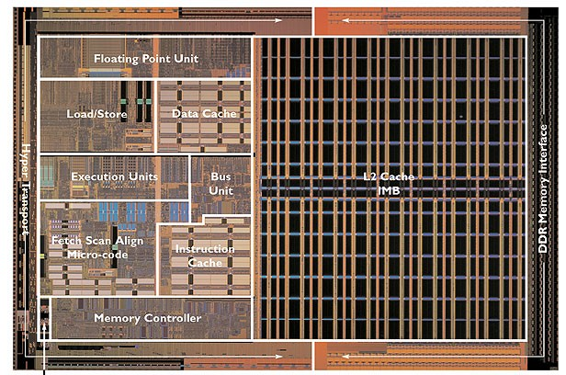
what is a cache
Today we’ll answer the following questions.
What are the challenges of building big, fast memory systems?
What is a cache?
Why caches work? (answer: locality)
How are caches organized?
Where do we put things -and- how do we find them?

Slide 12
cache structure
address
address
CPU
cache
SRAM
memory
DRAM
data
data
copy of memory location 204
copy of memory location 205
address tag
204 | byte | byte | byte | byte | ----- | byte
618 | byte | byte | byte | byte | ----- | byte
512
1400
cache line 0
cache line 1
a data block – consecutive addresses in memory

Slide 13
principle of locality
programs exhibit locality,
temporal locality - if a program accesses a memory address at time t, there is a good chance it will access the same address again within t + δ.
examples: loops for both data and instructions
spatial locality - if a program accesses memory address X, there is a good chance that it will also access other addresses within X ± d.
data: arrays and records
instruction: sequential execution

Slide 14
temporal locality in instructions
Loops are excellent examples of temporal locality in programs.
The loop body will be executed many times.
The computer will need to access those same few locations of the instruction memory repeatedly.
For example:
Each instruction will be fetched over and over again, once on every loop iteration.
Loop: lw $t0, 0($s1)
add $t0, $t0, $s2
sw $t0, 0($s1)
addi $s1, $s1, -4
bne $s1, $0, Loop

Slide 15
temporal locality in data
Programs often access the same variables over and over, especially within loops. Below, sum and i are repeatedly read and written.
Commonly-accessed variables can sometimes be kept in registers, but this is not always possible.
There are a limited number of registers.
There are situations where the data must be kept in memory, as is the case with shared or dynamically-allocated memory.
sum = 0;
for (i = 0; i < MAX; i++)
sum = sum + f(i);

Slide 16
spatial locality in instructions
Nearly every program exhibits spatial locality, because instructions are usually executed in sequence — if we execute an instruction at memory location i, then we will probably also execute the next instruction, at memory location i+1.
Code fragments such as loops exhibit both temporal and spatial locality.
sub $sp, $sp, 16
sw $ra, 0($sp)
sw $s0, 4($sp)
sw $a0, 8($sp)
sw $a1, 12($sp)

Slide 17

spatial locality in data
Programs often access data that is stored contiguously.
Arrays, like a in the code on the top, are stored in memory contiguously.
The individual fields of a record or object like employee are also kept contiguously in memory.
sum = 0;
for (i = 0; i < MAX; i++)
sum = sum + a[i];
employee.name = “Homer Simpson”;
employee.boss = “Mr. Burns”;
employee.age = 45;

Slide 18
how a cache works
on-chip
CPU
cache
(SRAM)
fast, small
memory
(DRAM)
large, slow
register file
(RF)
holds frequently used data
size: RF << cache << memory
latency: RF << cache << memory
bandwidth: on-chip >> off-chip
data ∈ cache ⇒ hit (fast access, ~ 1 CPU cycle)
data ∉ cache ⇒ miss (slow access, ~ 100s CPU cycles)

Slide 19
how caches take advantage of temporal locality
The first time the processor reads from an address in main memory, a copy of that data is also stored in the cache.
The next time that same address is read, we can use the copy of the data in the cache instead of accessing the slower dynamic memory.
So the first read is a little slower than before since it goes through both main memory and the cache, but subsequent reads are much faster.
This takes advantage of temporal locality—commonly accessed data is stored in the faster cache memory.
CPU
A little static
RAM (cache)
Lots of
dynamic RAM

Slide 20
how caches take advantage of spatial locality
When the CPU reads location i from main memory, a copy of that data is placed in the cache.
But instead of just copying the contents of location i, we can copy several values into the cache at once, such as the four bytes from locations i through i + 3.
If the CPU later does need to read from locations i + 1, i + 2 or i + 3, it can access that data from the cache and not the slower main memory.
For example, instead of reading just one array element at a time, the cache might actually be loading four array elements at once.
Again, the initial load incurs a performance penalty, but we’re gambling on spatial locality and the chance that the CPU will need the extra data.
CPU
A little static
RAM (cache)
Lots of
dynamic RAM

Slide 21
cache read operations
CPU read accesses memory
read HIT
data sent to CPU
YES
NO
found in cache?
read MISS
read data block from main memory
hit time = 1 CPU clock cycle
stall CPU, wait . . .
return data to CPU,
place block in cache,
line to replace?
which one?
miss time = 100s of CPU clock cycles

Slide 22
definitions: hits and misses
A cache hit
occurs if the cache contains the data that we’re looking for. Hits are good, because the cache can return the data much faster than main memory.
A cache miss
occurs if the cache does not contain the requested data. This is bad, since the CPU must then wait for the slower main memory.
There are two basic measurements of cache performance.
The hit rate is the percentage of memory accesses that are handled by the cache.
The miss rate (1 - hit rate) is the percentage of accesses that must be handled by the slower main RAM.
Typical caches have a hit rate of 95% or higher, so in fact most memory accesses will be handled by the cache and will be dramatically faster.
In future lectures, we’ll talk more about cache performance.
Today we’ll talk about implementation!

Slide 23
cache operation
Address (32 bits)
Index
Valid
Tag
Data
0
1
2
3
...
...
1022
1023
22
10
Index
To CPU
Tag
=
Hit
direct mapped cache: modulo hashing
1K cache lines
10 bits for index (modulo mapping)
22 bits for address tag (32 -10)
cache hit 🡸➔ [stored tag == address tag] ∧[valid bit == 1]

Slide 24
associative caches
Fully associative
Allow a given block to go in any cache entry
Requires all entries to be searched at once
Comparator per entry (expensive)
n-way set associative
Each set contains n entries
Block number determines which set
(Block number) modulo (#Sets in cache)
Search all entries in a given set at once
n comparators (less expensive)

Slide 25
cache associativity
block #
0 | 1 | 2 | 3 | 4 | 5 | 6 | 7 | 8 | 9 | 10 | 11 | 12 | 13 | 14 | 15 | 16 | 17 | 18 | 19 | 20 | 21 | 22 | 23 | 24 | 25 | 26 | 27 | 28 | 29 | 30
main memory
direct mapped
0 | 1 | 2 | 3 | 4 | 5 | 6 | 7
20 mod 8 = 4
one cache line per index
2-way set
associative
0 |  |  | 1 |  |  | 2 |  |  | 3
20 mod 4 = 0
two cache lines per index
0 | 1 | 2 | 3 | 4 | 5 | 6 | 7
anywhere
fully
associative

Slide 26
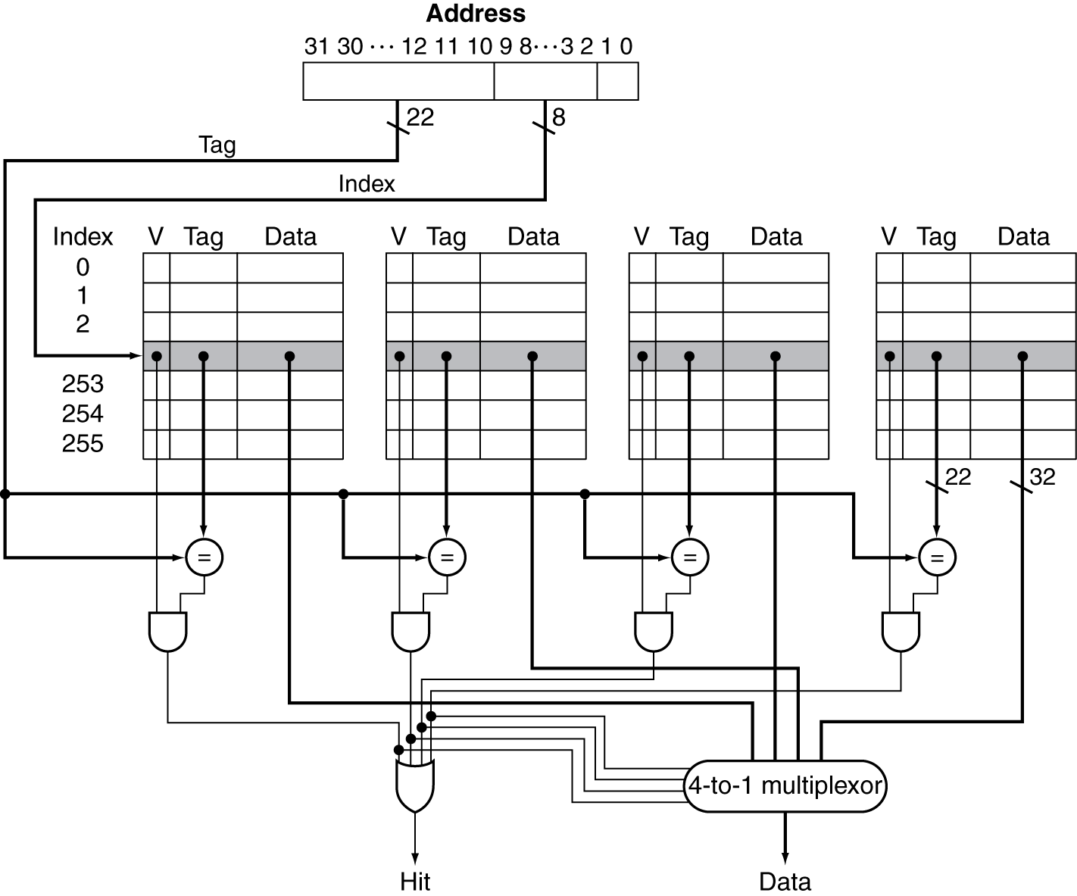
4-way set associative cache organization
n-way set associative cache is n direct mapped caches in parallel with an n-way multiplexor

Slide 27
address and the cache
address 32 bits
tag
index
offset
block address
b bits
size of block = 2^{b}
no. bits in index = ln (no. sets in cache)
associativity = no. of lines per set
cache size = block size * no. of lines =
block size * no. of sets * associativity

Slide 28
how much associativity?
Increased associativity decreases miss rate
But with diminishing returns
Simulation of a system with 64KB D-cache, 16-word blocks, SPEC2000
1-way: 10.3%
2-way: 8.6%
4-way: 8.3%
8-way: 8.1%
miss rate flattens out after 8-way

Slide 29
sources of misses: the 3 Cs
compulsory misses (aka cold start misses)
first access to a block
capacity misses
due to finite cache size
a replaced block is later accessed again
conflict misses (aka collision misses)
in a non-fully associative cache
due to competition for entries in a set
would not occur in a fully associative cache of the same total size

Slide 30
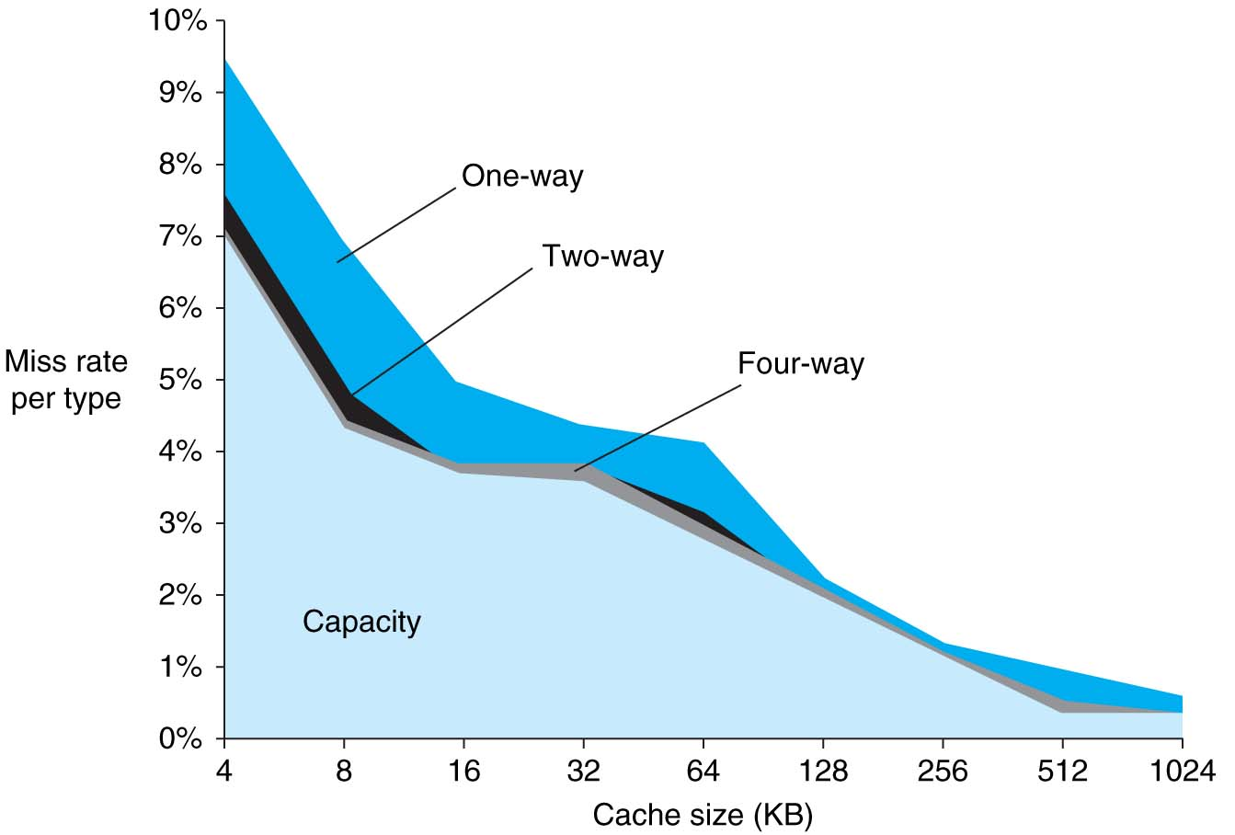
analysis of misses
SPEC2000 INT & FP:
compulsory misses: 0.006%, not visible
capacity misses reduced by cache size
conflict misses depend on associativity and cache size

Slide 31
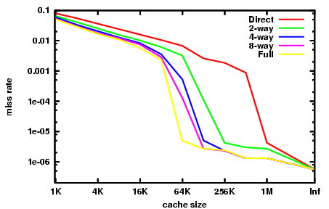
analysis of misses
capacity misses dominate
conflict misses dominate
compulsory misses dominate

Slide 32
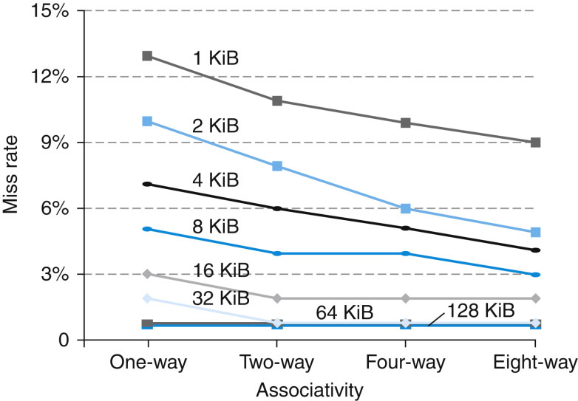
miss rate v/s sized and associativity

Slide 33
what if the cache fills up?
what to do if we run out of space in our cache, or if we need to reuse a block for a different memory address.
A miss causes a new block to be loaded into the cache, automatically overwriting any previously stored data.
This is a least recently used replacement policy, which assumes that older data is less likely to be requested than newer data.
There are other policies
this must be done in less than one cycle!

Slide 34
write hit strategy
write through
on data-write hit, could just update the block in cache but then cache and memory would be inconsistent
write through: update cache and memory
but makes writes take longer
e.g., if base CPI = 1, 10% of instructions are stores, write to memory takes 100 cycles ==> effective CPI = 1 + 0.1×100 = 11
solution: write buffer
holds data waiting to be written to memory
CPU continues immediately
Only stalls on write if write buffer is already full
write back
on data-write hit, just update the block in cache
keep track of whether each block is dirty: dirty bit
when a dirty block is replaced write it back to memory
use a write buffer to allow replacing block to be read first

Slide 35
which is better?
write through or write back?

Slide 36
write allocate
What should happen on a write miss?
Alternatives for write-through
Allocate on miss: fetch the block
Write around: don’t fetch the block
Since programs often write a whole block before reading it (e.g., initialization)
For write-back
Usually fetch the block

Slide 37
Example: Intrinsity FastMATH
Embedded MIPS processor
12-stage pipeline
Instruction and data access on each cycle
Split cache: separate I-cache and D-cache
Each 16KB: 256 blocks × 16 words/block
D-cache: write-through or write-back
SPEC2000 miss rates
I-cache: 0.4%
D-cache: 11.4%
Weighted average: 3.2%

Slide 38
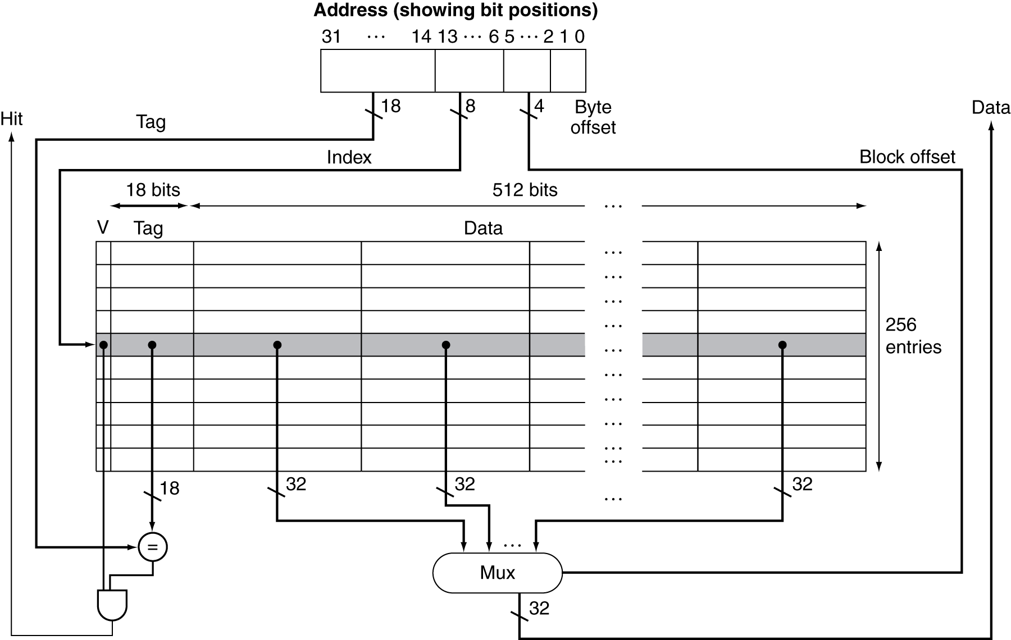
Example: Intrinsity FastMATH

Slide 39
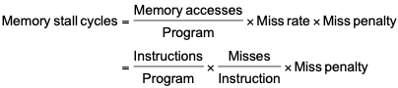
cache performance
Components of CPU time
Program execution cycles: Includes cache hit time
Memory stall cycles: Mainly from cache misses
With simplifying assumptions:

Slide 40
cache performance example
Given
I-cache miss rate = 2%
D-cache miss rate = 4%
Miss penalty = 100 cycles
Base CPI (ideal cache) = 2
Load & stores are 36% of instructions
Miss cycles per instruction
miss cycles due to I-cache = 0.02 × 100 = 2
miss cycles due to D-cache = 0.36 × 0.04 × 100 = 1.44
Actual CPI
actual CPI = Ideal CPI + cache miss cycles = = 2 + 2 + 1.44 = 5.44

Slide 41
Average Memory Access Time
Hit time is also important for performance
Average memory access time (AMAT)
AMAT = Hit time + Miss rate × Miss penalty
Note: the cache is always accessed, whether it is a hit or a miss

Slide 42
Example
Example
CPU with 1 ns clock, hit time = 1 cycle, miss penalty = 20 cycles,
I$ miss rate = 6%, D$ miss rate = 12%
load and store are 40% of instructions
Compute the AMAT:
Compute the real CPI assuming the ideal CPI is 2 cycles/instruction
AMAT = hit time + miss rate x miss penalty
I$ AMAT = 1 + 0.06x20 = 2.2 ns
D$ AMAT = 1 + 0.12x20 = 3.4 ns
AMAT = (1 x I$ AMAT + 0.4 x D$ AMAT)/1.4
= (2.2 + 0.4x3.4)/1.4 = 2.53 ns
real CPI = ideal CPI + stall cycles/instruction
I$ stall cycles = 0.06x20 = 1.2 ns per instruction fetched
D$ stall cycles = 0.12x20 = 2.4 ns per load or store instruction
stall cycles/instruction = I$ stall cycles + 0.4 x D$ stall cycles
= (1.2 + 0.4x2.4) = 2.16 cycles/instruction
real CPI = 2 + 2.16 = 4.16 cycles/instruction

Slide 43
performance summary
When CPU performance increased
Miss penalty becomes more significant
Decreasing base CPI
Greater proportion of time spent on memory stalls
Increasing clock rate
Memory stalls account for more CPU cycles
Can’t neglect cache behavior when evaluating system performance

Slide 44
replacement policy
direct mapped: no choice
set associative
Prefer non-valid entry, if there is one
Otherwise, choose among entries in the set
replacement algorithms
least-recently used (LRU)
choose the one unused for the longest time
simple for 2-way, manageable for 4-way, too hard beyond that
random
gives approximately the same performance as LRU for high associativity
FIFO
used in high associativity caches
why do we need them since no benefit on hit rate beyond 8-way?

Slide 45
stack replacement algorithms
a replacement algorithm is called a stack algorithm iff
Set(n, t) ⊂ Set(n+1, t)
which means that the set of blocks found in a cache of size n is a subset of those found in a one of size n+1
LRU and LFU are stack replacement algorithm
FIFO is not: the (László) Bélády anomaly (also called FIFO anomaly)

Slide 46
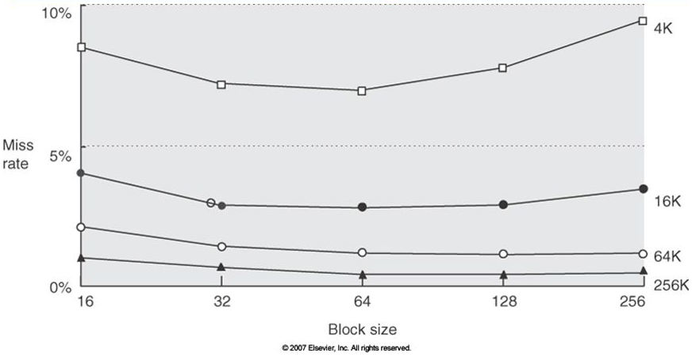
block size
block = unit of data transfer between cache and memory
larger block size, pluses
exploit more spatial locality
faster burst transfer from DRAM
larger block size, minuses
fewer blocks (fixed size cache) ==> more conflicts
wasted bandwidth
limited spatial locality
address 32 bits
block address
offset
2^{b} = block size in bytes
b bits

Slide 47
cache design trade-offs
Design change | Effect on miss rate | Negative performance effect
Increase cache size | Decrease capacity misses | May increase access time
Increase associativity | Decrease conflict misses | May increase access time
Increase block size | Decrease compulsory misses | Increases miss penalty. For very large block size, may increase miss rate due to pollution.

Slide 48
multilevel caches
Primary cache attached to CPU
Small, but fast
Level-2 cache services misses from primary cache
Larger, slower, but still faster than main memory
Main memory services L-2 cache misses
Some high-end systems include L-3 cache
L1
cache
L2
cache
memory
(DRAM)
CPU

Slide 49
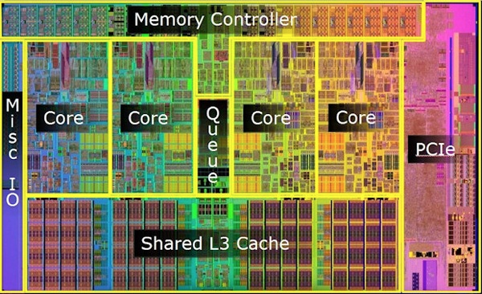
Intel i7 (Nehalem)

Slide 50
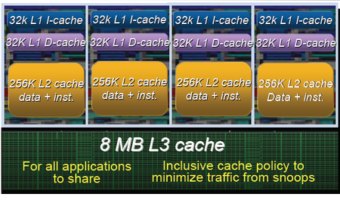
Intel i7 (Nehalem)
private L1 and L2 caches
L1 separate I$ & D$
L2 unified (I & D)
L2 latency: 10 cycles
shared L3, ~40 cycles latency

Slide 51
multilevel cache example
Given
CPU base CPI = 1, clock rate = 4 GHz
Miss rate/instruction = 2%
Main memory access time = 100 ns
With just primary cache
Miss penalty = 100 ns/0.25 ns = 400 cycles
Effective CPI = ideal CPI + miss rate x miss penalty = 1 + 0.02 × 400 = 9

Slide 52
example (cont.)
Now add L-2 cache
Access time = 5 ns
Global miss rate to main memory = 0.5%
Primary miss with L-2 hit
Penalty = 5 ns/0.25 ns = 20 cycles
Primary miss with L-2 miss
Extra penalty = 500 cycles
CPI = 1 + 0.02 × 20 + 0.005 × 400 = 3.4
Performance ratio = 9/3.4 = 2.6

Slide 53
multilevel cache considerations
Primary cache
Focus on minimal hit time
L-2 cache
Focus on low miss rate to avoid main memory access
Hit time has less overall impact
Results
L-1 cache usually smaller than a single cache
L-1 block size smaller than L-2 block size

Slide 54
interactions with advanced CPUs
Out-of-order CPUs can execute instructions during cache miss
Pending store stays in load/store unit
Dependent instructions wait in reservation stations
Independent instructions continue
Effect of miss depends on program data flow
Much harder to analyse
Use system simulation

Slide 55
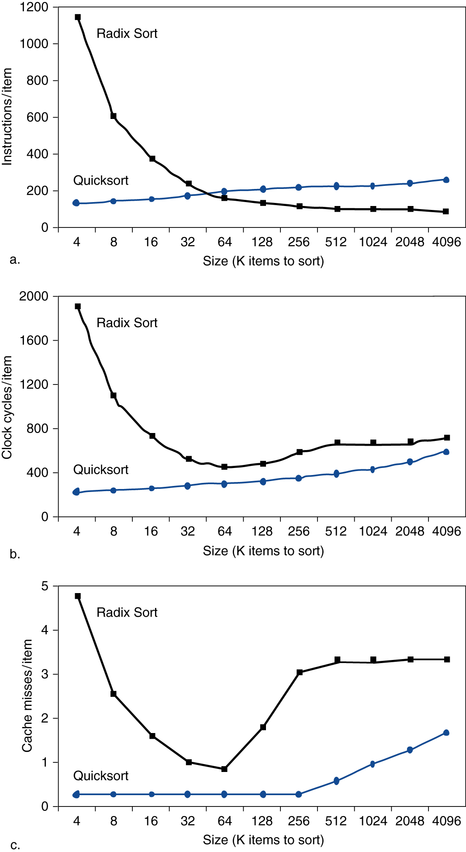
interactions with software
Misses depend on memory access patterns
Algorithm behavior
Compiler optimization for memory access

Slide 56
victim cache
concept
hold an evicted block in a victim cache
very small fully associative cache (e.g. 4 entries)
catches all the blocks victims of conflict misses
cheap way to reduce conflict misses without the cost in cache delay or chip area
CPU
L1
D$
VC
L2
cache

